Slide 1


INDUSTRY REVIEW PANEL PRESENTATION
sdmay26-44
Culinary Command

Slide 2





SDMAY26-44
CULINARY COMMAND
THE TEAM
Matayas Durr
Software Engineering
Wyatt Hunter
Software Engineering
Kevin Tran
Software Engineering
Anthony Phan
Software Engineering
Ryan Rockey
Software Engineering
Frontend Developer & Client Liaison
Backend & Architecture Lead
Backend Lead / Security & Infrastructure
Frontend & UI/UX Developer
Frontend & UI/UX Developer

Slide 3
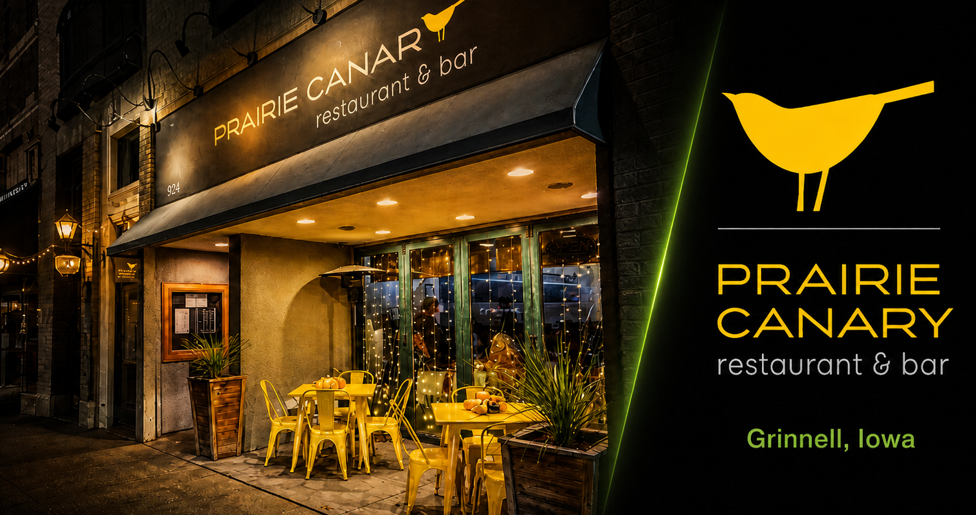

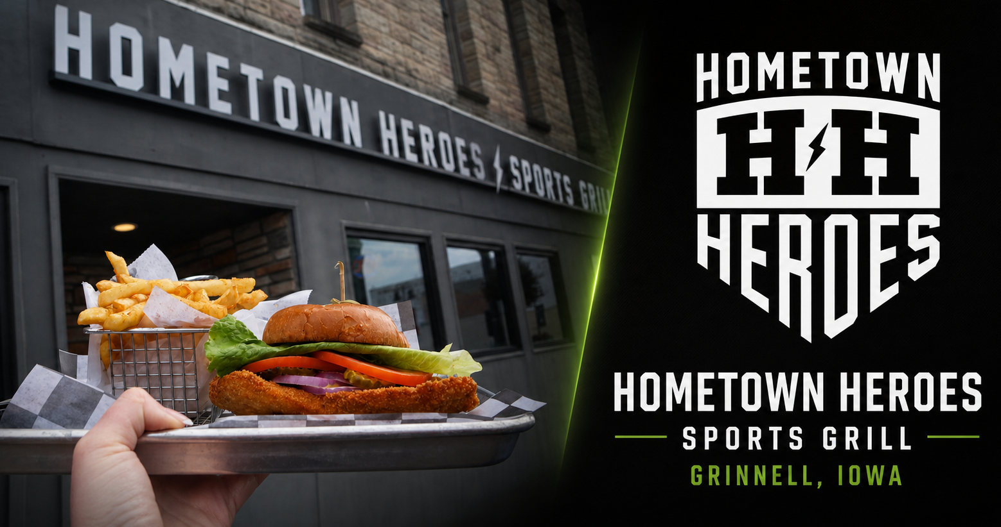

SDMAY26-44
CULINARY COMMAND
PROJECT ORIGIN
Culinary Command began with a real client need.
Paul Durr, co-owner of Prairie Hospitality Group,
Operates two restaurants in Grinnell, Iowa.
Needed a better way to assign, track, and communicate daily back-of-house tasks

Slide 4

SDMAY26-44
CULINARY COMMAND
THE PROBLEM
Restaurants still rely on:
This leads to:
Verbal communication
Handwritten prep lists
Inconsistent workflows
Missed or duplicated tasks
Confusion between shifts
No accountability or tracking
No centralized system for managing back of house tasks.

Slide 5
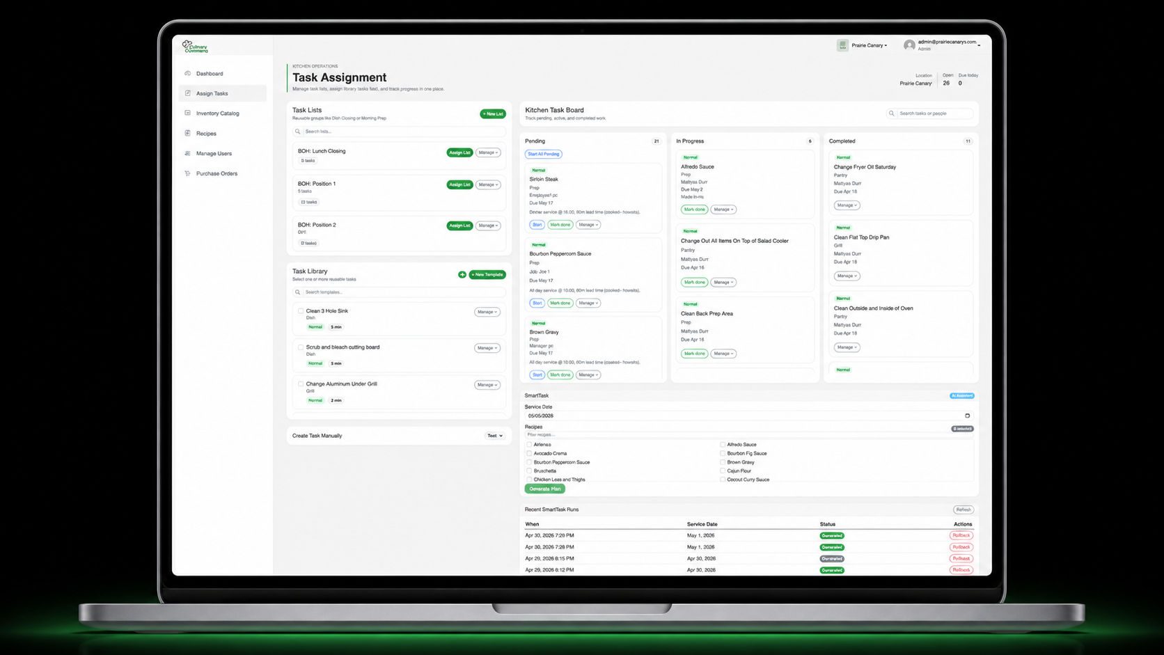




SDMAY26-44
OUR SOLUTION:
Culinary Command centralizes daily kitchen operations into one role-based web application
How it Works:
1
Managers build reusable task lists
Morning prep, closing, cleaning, inventory checks
2
Tasks are assigned by shift or employee
Employees see only the work they are responsible for
3
Progress is tracked throughout the day
Managers can view pending, in-progress, and completed work
4
Inventory supports prep decisions
Par, count, and prep amounts help determine what needs to be made
Task Management
Templates, task lists, bulk assignment, live status tracking
Inventory Management
Par levels, counts, prep amounts, catalog organization
Employee Management
Role-based access, location assignment, personal task views
The system replaces scattered paper lists with a shared workflow for managers and employees.

Slide 6
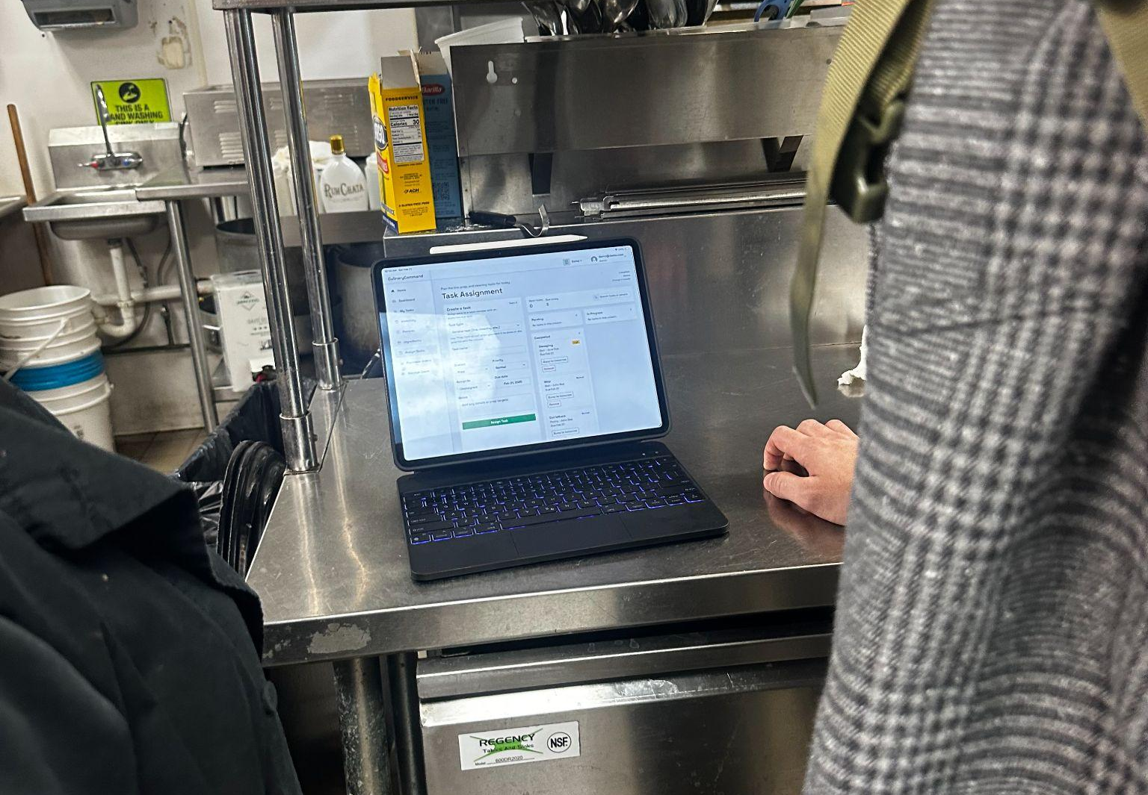
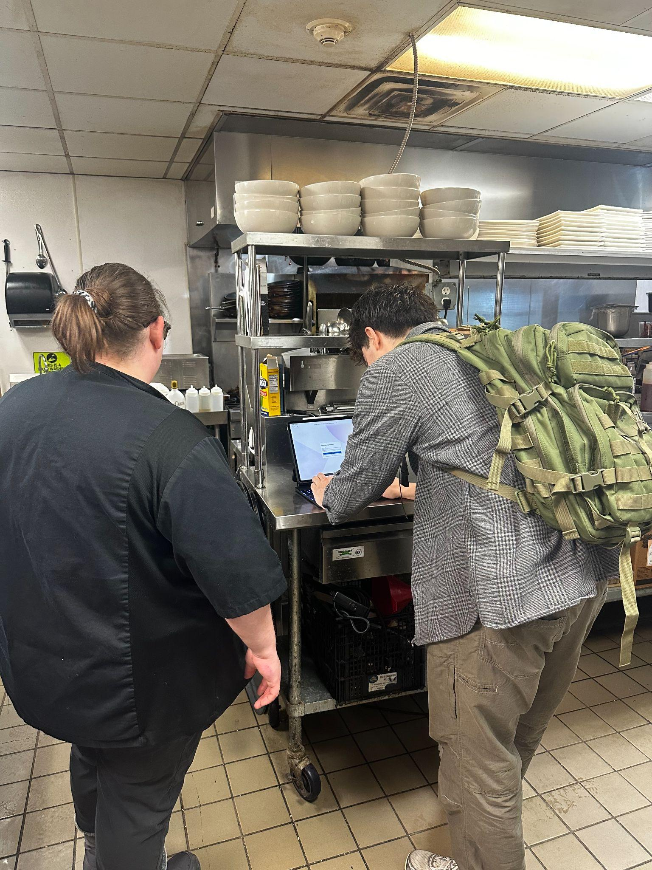


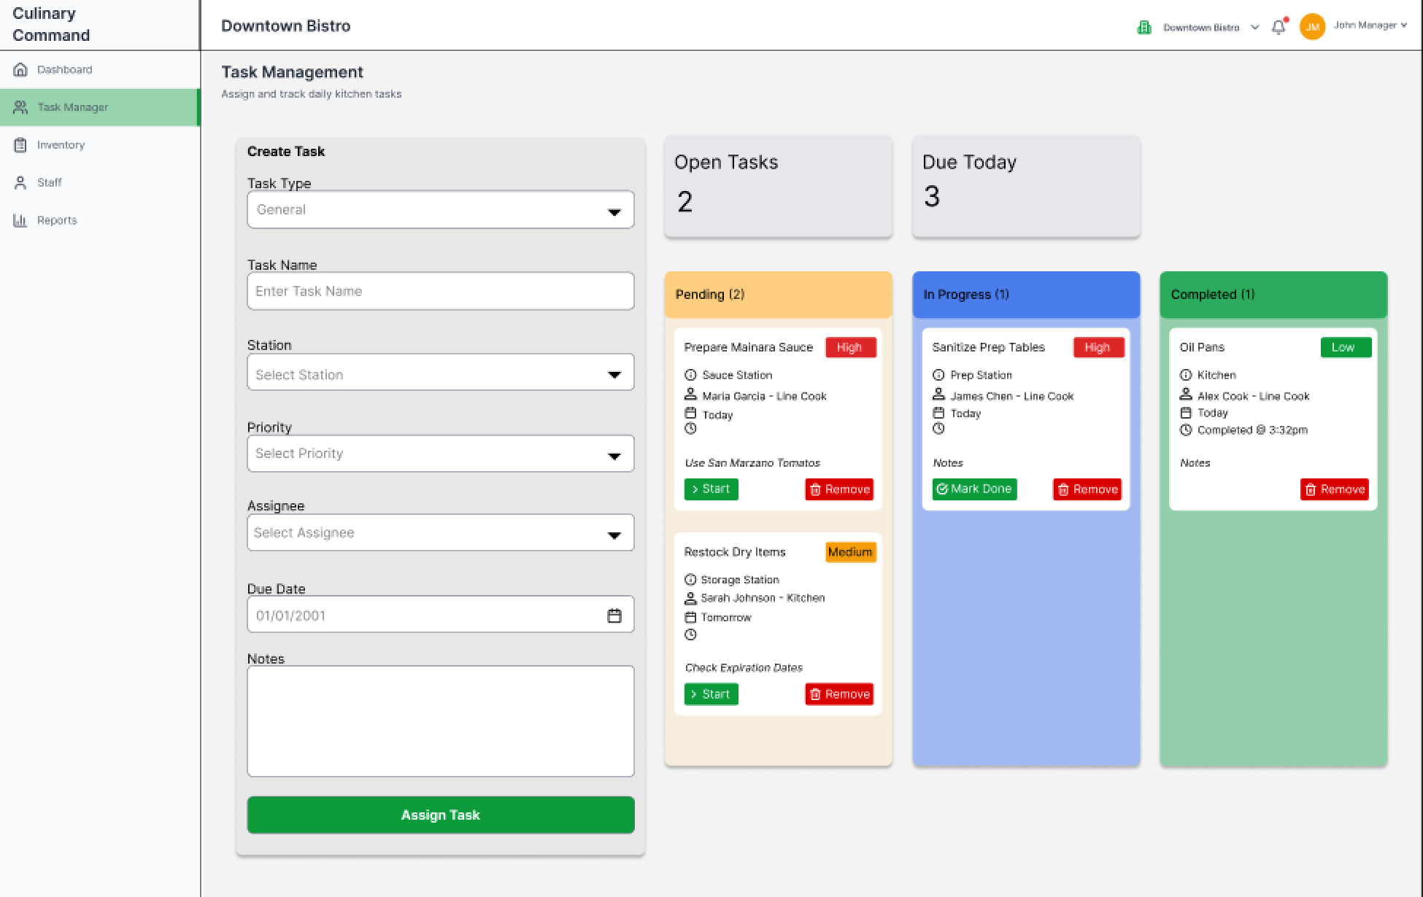
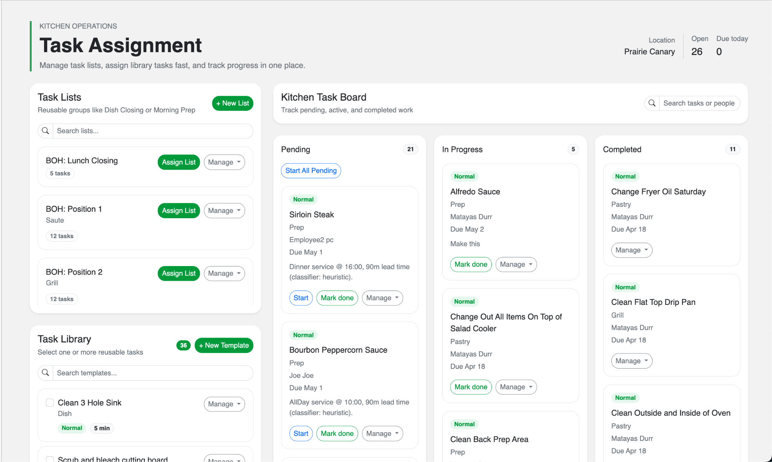

SDMAY26-44
CULINARY COMMAND
LIVE DEMO & ITERATION
Two in-person demos at Prairie Canary in Grinnell, Iowa
Demo 1
Early task assignment workflow
Validated the core concept in a real kitchen
Used the original Task Assignment Page
Demo 1 (Before)
Current (Refined)
Demo 2
Demonstrated a more refined system
Confirmed the product fit the restaurant workflow
Feedback led to small improvements
  Employees should be able to view completed tasks again
  Daily tasks lists appear automatically at set times
The live demos showed that Culinary Command works in a real kitchen environment and helped guide improvements.

Slide 7
CULINARY COMMAND
Demo 1 (Before)
Current (Refined)

Slide 8
CULINARY COMMAND
Our Approach
1
HOW WE WORKED
2
HOW WE BUILT
3
HOW WE SHIPPED
Process & Methodology
Tech Stack & Architecture
DevOps & CI/CD
Agile sprints → Kanban
Blazor Server + .NET9
GitHub Actions pipeline
Shifted mid-project when schedule constraints made fixed sprints unsustainable
Modern open-source framework using C# (User Interface)
Automated code checks, unit tests, and end-to-end (E2E) tests on every push
Two in-person client demos
Lightsail → EC2 ASG migration
Layered testing strategy
Iterated based on real kitchen feedback
Outgrew original infrastructure and upgraded mid-project
Unit → Integration → E2E → Load Testing
Client-driven requirements
Modular feature architecture
Jira project board
Prairie Hospitality Group’s needs shaped the feature set
Inventory, Recipe, SmartTask implemented as isolated modules
Shared view of capacity, everyone knew what was in flight and what was next

Slide 9
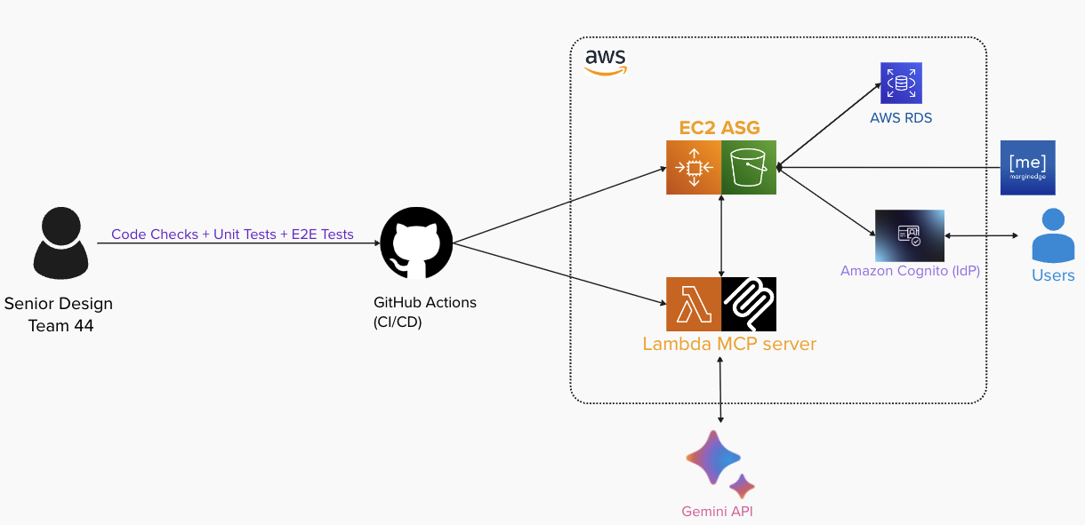
SDMAY26-44
CULINARY COMMAND
System Architecture Overview

Slide 10

CULINARY COMMAND
GitHub Actions
Delivering value to our workflow
346
241
55s
3s
TOTAL MINUTES
TOTAL JOB RUNS
AVG JOB RUN TIME
AVG QUEUE TIME
CI/CD time invested
automated executions
fast feedback loops
nearly instant start
8%
WHY IT MATTERS
320 minutes of productive CI time
JOB FAILURE RATE
241 manual tasks eliminated
26 minutes lost to failed jobs
92% of jobs succeed on first run
55s average feedback loops enable rapid iteration
3s queue time means developers never wait to start

Slide 11
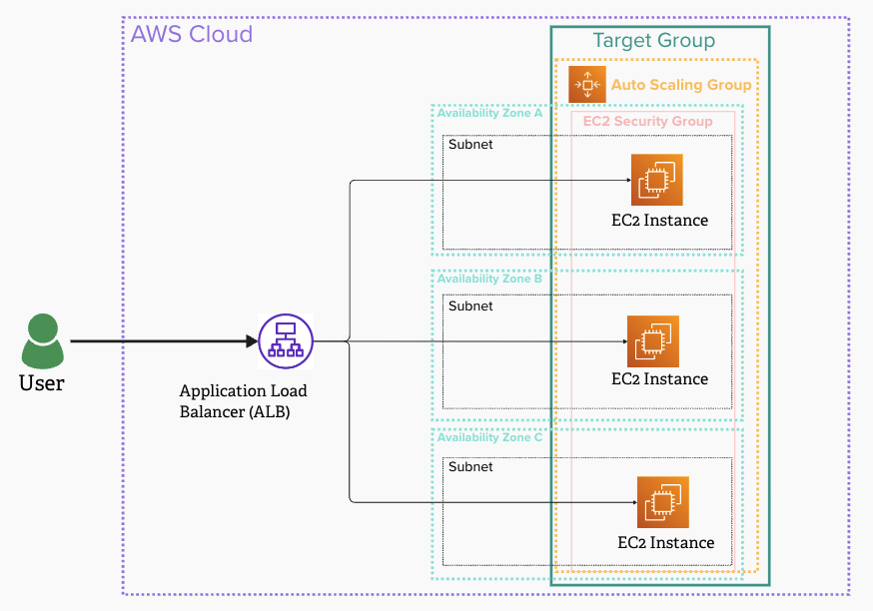
CULINARY COMMAND
EC2 Auto Scaling Architecture
Fault Resistant
Instances span across 3 availability zones
Elastic Capacity
Auto Scaling Group adds or removes instances based on demand
Resilient By Design
Failed instances are detected and replaced without any manual intervention
Application load balancer spreads traffic evenly across all instances

Slide 12
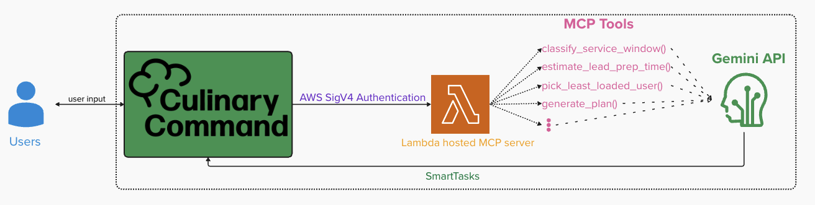
CULINARY COMMAND
Model Context Protocol (MCP) Server Architecture
An MCP server allows us to connect our Culinary Command application to an LLM.

Slide 13
SDMAY26-44
Tech Stack & Modular Architecture
Dashboard/
Dynamic live activity charts and graphs
SmartTask/
AI-driven kitchen task planning
Inventory/
Catalog, stock adjustments, and live transactions
Recipe/
Creation, editing, and dynamic scaling
PurchaseOrder/
Order management and supplier creation
Foundational Tech Stack
Blazor Server on .NET 9
C# UI
Blazor Interactive Server render mode via SignalR
Notes:
Switched from Agile to Khanban style, where we found that this style work better for us, due to constant changes from feedback

Slide 14
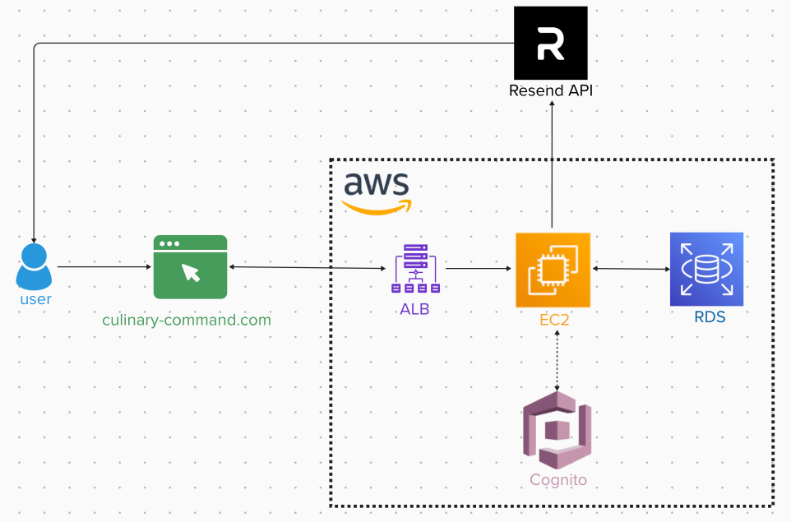
SDMAY26-44
CULINARY COMMAND
Backend Architecture
Blazor Server + ASP.NET
  Client (browser) connects to server via SignalR
Client:
  Sends user events (clicks, inputs)
  Receives UI updates from server
Notes:
Blazor essentially = Server-driven UI model

Slide 15

CULINARY COMMAND
Lightsail vs. EC2
Blazor is more backend heavy
Memory constraints with Lightsail
Multi-region zones ensure highest uptime

Slide 16
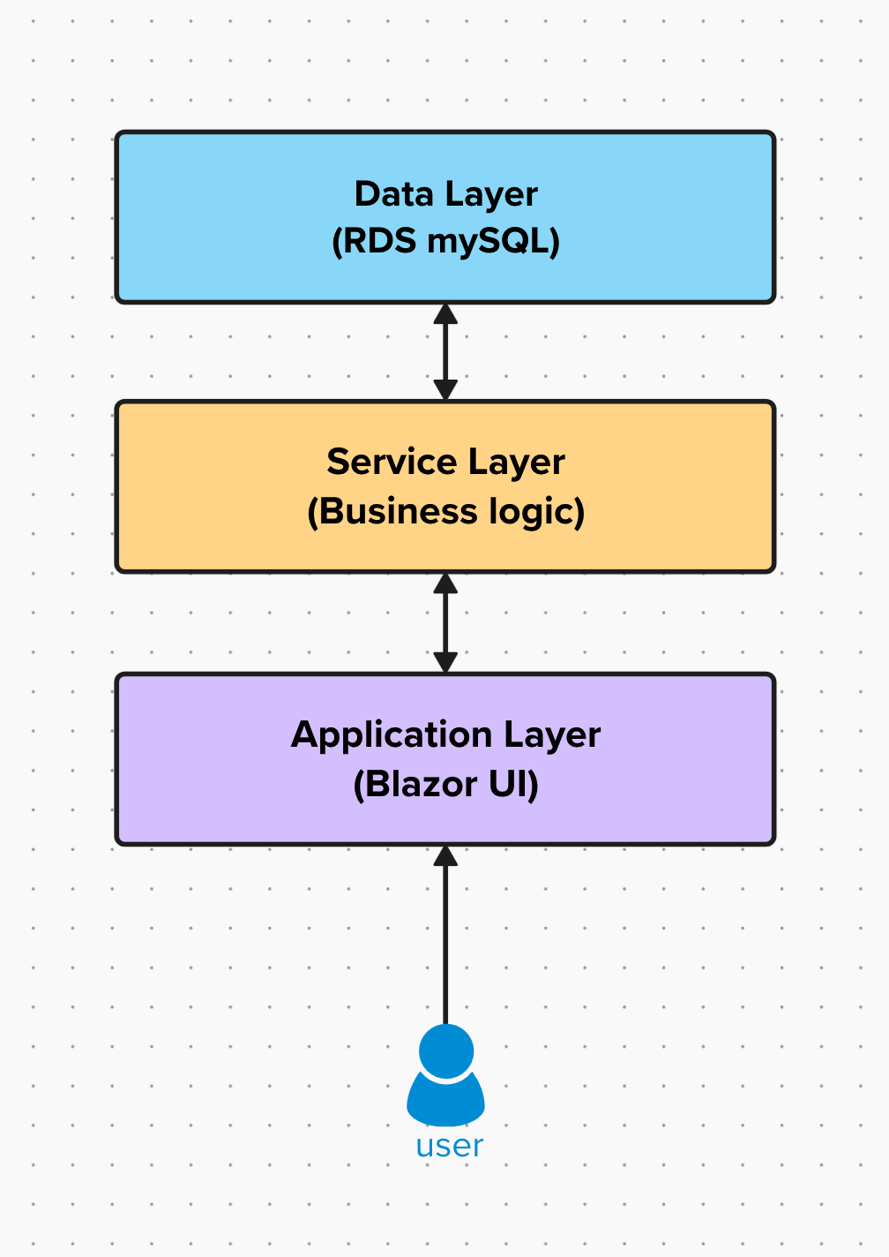
SDMAY26-44
CULINARY COMMAND
Service Layer
Layer between UI and external systems
Example for User & Auth:
  UserService
  CognitoProvisioningService
Interface-driven design
  TaskService implements ITaskService
Dependency injection
  Loose coupling
Notes:
Encapsulate core operations

Slide 17


SDMAY26-44
CULINARY COMMAND
Integrations
Authentication and user provisioning
  AWS Cognito
Email system for onboarding
  Resend API
Database migrations and access
  .NET EF Core
Notes:
Cognito-
Security: salting and hashing, token management, allows MFA if we wanted
Reduced maintenance: team doesn’t need to handle Auth as much, cognito provides user management and login flows

Slide 18
CULINARY COMMAND
Frontend Role Based Access
SDMAY26-44
User Login
AWS Cognito
Extract Role Claims
Secure Cookie-Based Session
Admin
Manager
Employee
Complete system control
Global company configurations
User lifecycle management
Dashboard analytics access
Manual & AI task management
Inventory, Recipes & Purchase orders
Strictly locked down interface
Rendered “My Tasks” only
Minimal views
Works on all devices (Mobile, Tablet, and Desktop)

Slide 19
CULINARY COMMAND
Frontend State Management & Real Time Sync
SDMAY26-44
LocationState Service
- Implements the Observer Pattern
- Broadcasts active location changes across UI components instantly
Server-Side State
ITaskNotificationService
- Real time task status updates
- Dashboard updates to admins and managers
UserContextService
- Dynamically injects the current user’s role, identity, and location context
- Drives conditional UI rendering without manual refreshes

Slide 20
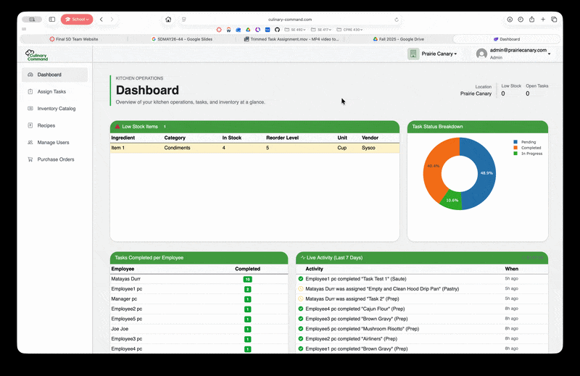
SDMAY26-44
CULINARY COMMAND
Frontend Demos
LocationStateService

Slide 21
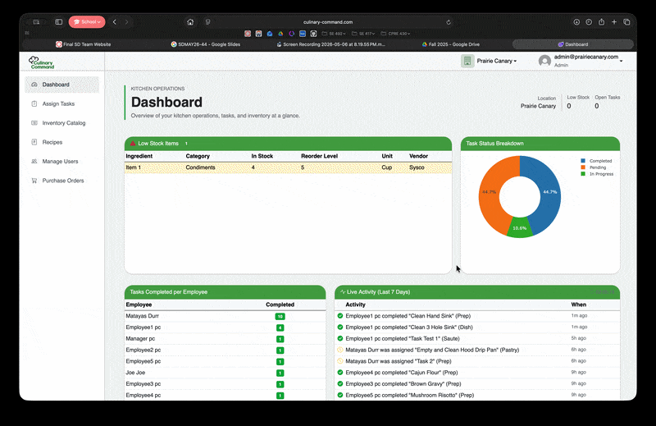
SDMAY26-44
CULINARY COMMAND
Frontend Demos
ITaskNotificationService

Slide 22
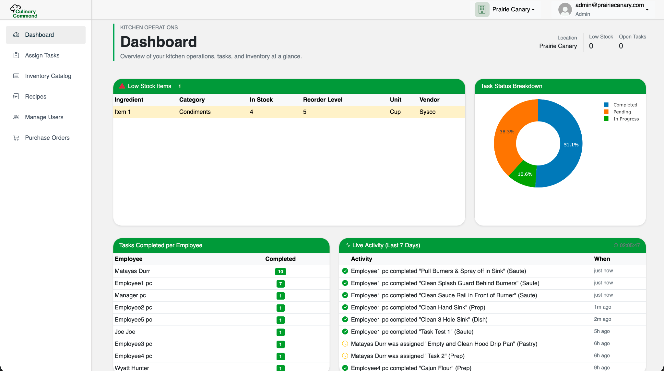
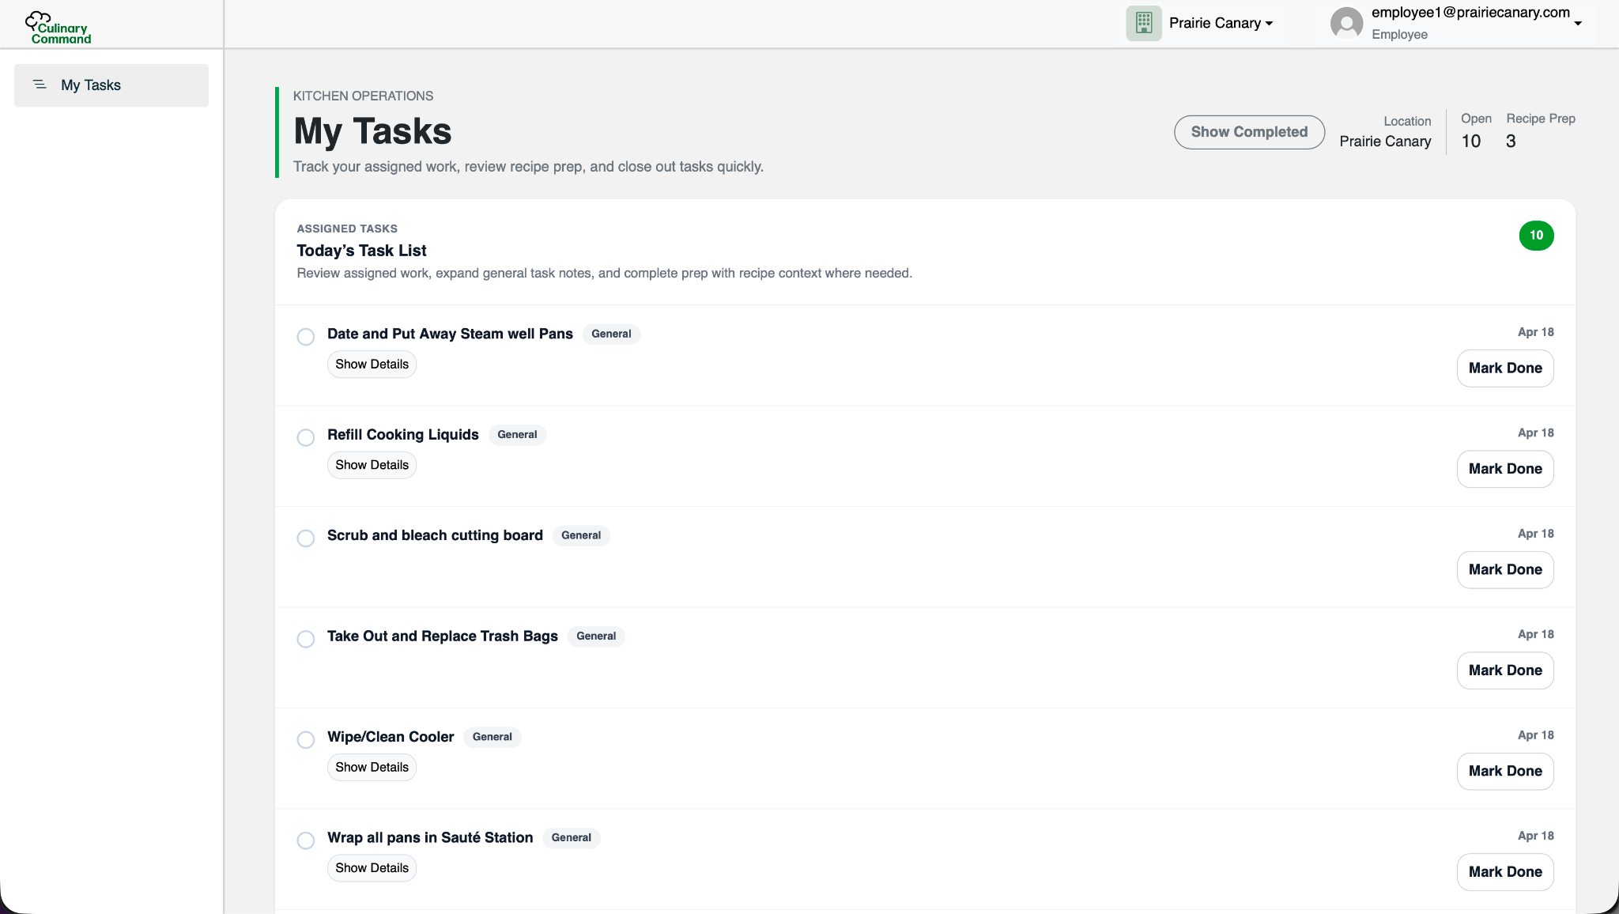
SDMAY26-44
CULINARY COMMAND
Frontend Views
Employee View
Admin/Manager View

Slide 23
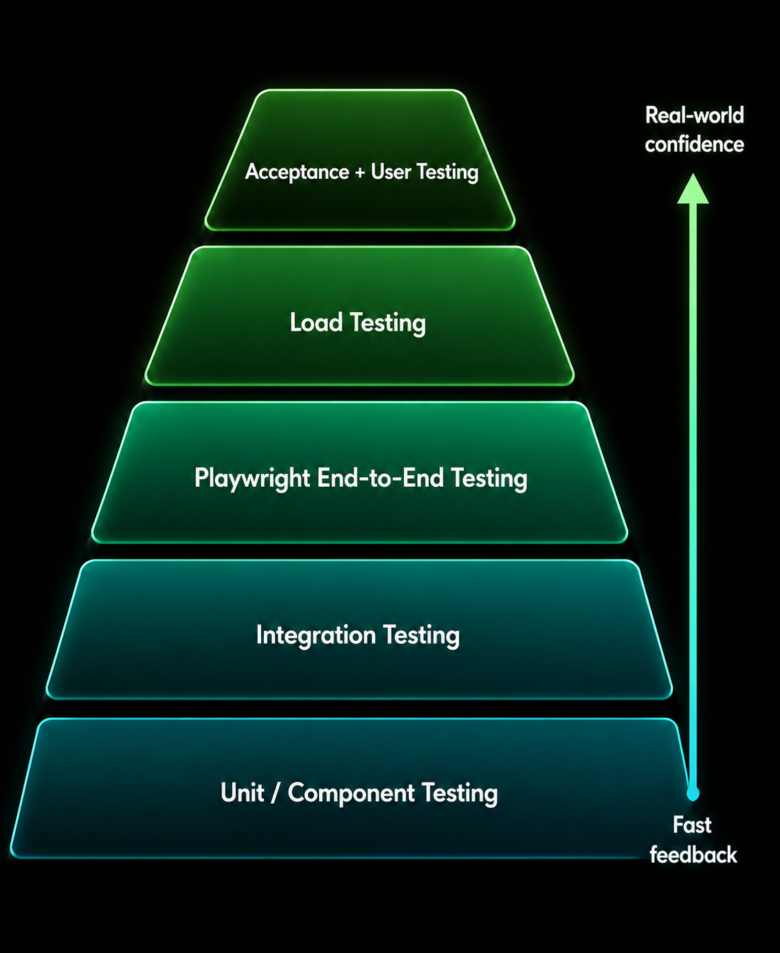
SDMAY26-44
CULINARY COMMAND
Testing Strategy: Layered Validation
Goal: Validate critical workflows across the UI, backend, database, and authentication system.
Unit/component testing - validate models, DTOs, and business rules
Integration tests - verify services, database behavior, and role-based access control
Playwright E2E testing - simulate real Admin, Manager, and Employee workflows in the browser
Locust load testing - measure responsiveness under simulated traffic
Acceptance / User testing - validate workflows with client-focused scenarios

Slide 24
SDMAY26-44
CULINARY COMMAND
Automated Workflow Testing
Area | Validated
Authentication | Cognito redirect + authenticated dashboard access
User Management | Invites, CRUD operations, validation, role assignment
Task Management | CRUD, assign, update status, verify board changes
Inventory | CRUD, search/filter, update stock, low-stock detection
Recipes/Ingredients | CRUD, connect ingredients, produce validation
Location/Tenant Views | Tenant-specific data and location based access
Role Views | Admin, Manager, Employee workflow visibility

Slide 25
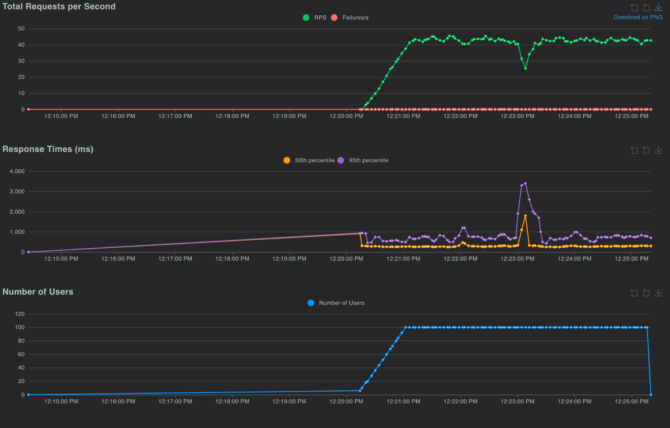
SDMAY26-44
CULINARY COMMAND
Load Testing
Used Locust to simulate HTTP traffic against Culinary Command
Measured request volume, active users, and response-time percentiles
Tracked average/median behavior and ranked 95th percentile worst-case response time
Established a baseline for infrastructure capacity
Future work: repeat load tests as features and real restaurant data increase

Slide 26
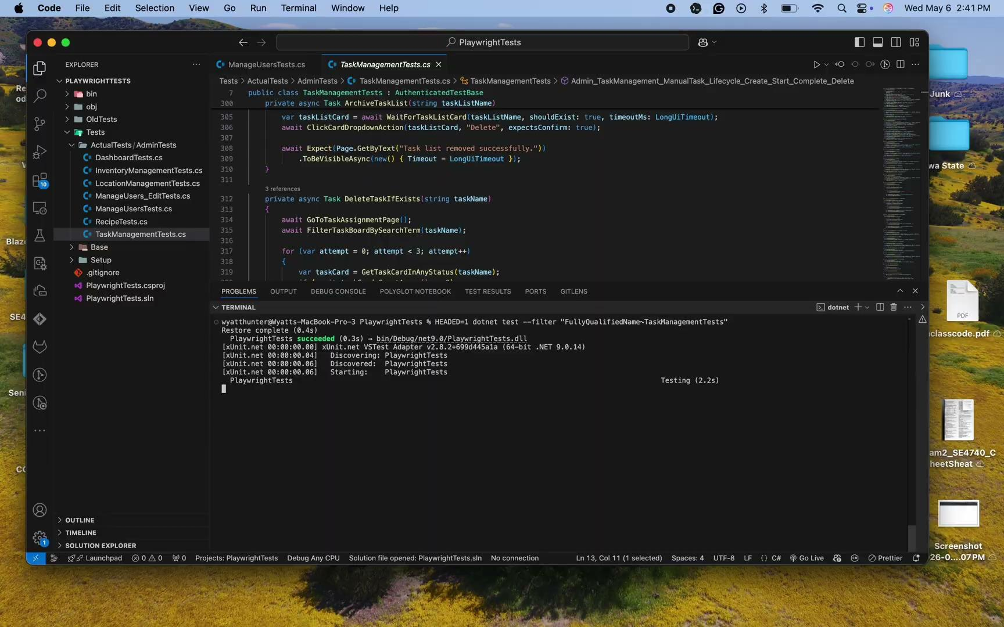
CULINARY COMMAND
PlayWright Example

Slide 27
SDMAY26-44
CULINARY COMMAND
Takeaways
Adaptability matters more than a perfect plan
Working with real cloud infrastructure gave us an experience much closer to industry software development than a typical classroom assignment
Learned the importance of end-to-end testing as the application scaled
User feedback helped prioritize which features actually delivered value instead of just being technically interesting

Slide 28

SDMAY26-44
CULINARY COMMAND
Q&A
https://culinary-command.com

